Slide 1
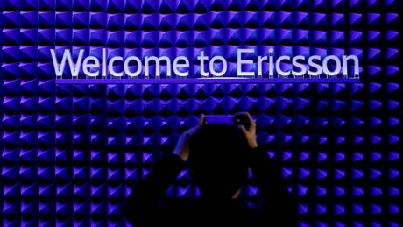
TDC shuns Huawei and selects Ericsson for 5G
Team Exam 1.semester
5th. December 2019

Slide 2
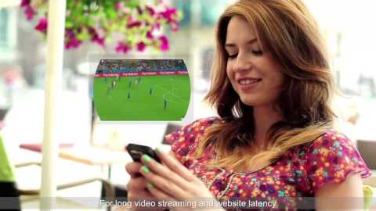
Denmark Best NetworkTDC Quality Brand MBB Success Story (Youtube 2019)

Slide 3
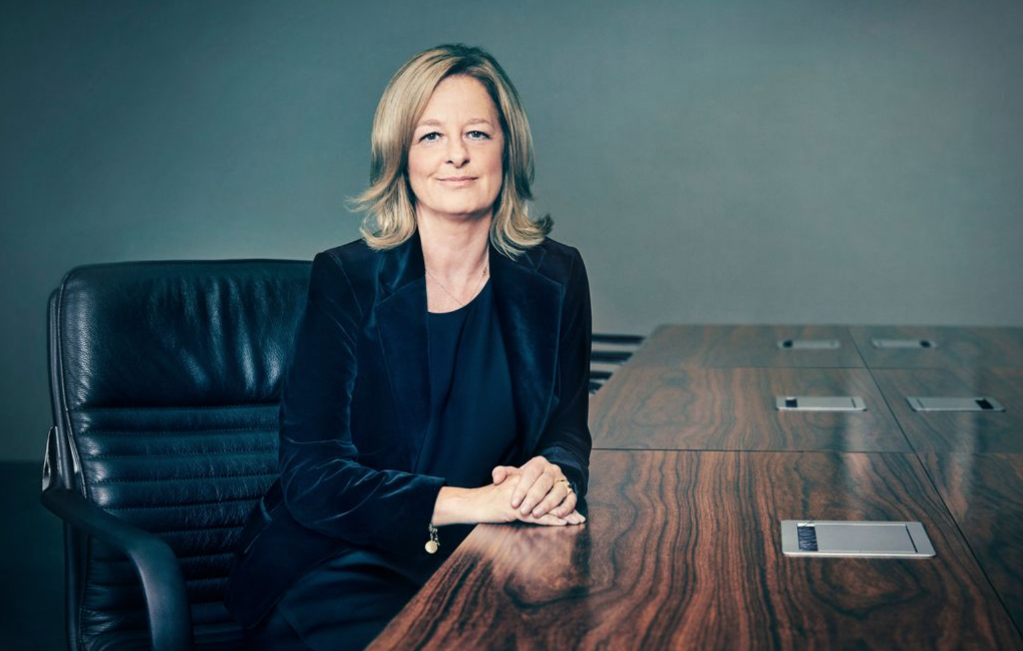
“What we had were two bids from Ericsson and Huawei and a tough negotiating process,” said Allison Kirkby, CEO of TDC
ComputerWeekly.com 2019

Slide 4


